Slide 1
Multithreading and Networking
Multithreading:
Creating Threads,
Thread scheduling and priority,
Thread interruptions and synchronization.
Network Programming:
InetAddress,
URLs,
Socket (TCP & UDP) communication in Java, Servlet Programming

Slide 2
Multithreading
Multithreading in Java
is a process of executing multiple threads simultaneously.
A thread is a lightweight sub-process, the smallest unit of processing. Multiprocessing and multithreading, both are used to achieve multitasking.
However, we use multithreading than multiprocessing because threads use a shared memory area. They don't allocate separate memory area so saves memory, and context-switching between the threads takes less time than process.
Java Multithreading is mostly used in games, animation, etc.

Slide 3
Advantages of Java Multithreading
1) It doesn't block the user because threads are independent and you can perform multiple operations at the same time.
2) You can perform many operations together, so it saves time.
3) Threads are independent, so it doesn't affect other threads if an exception occurs in a single thread.

Slide 4
What is Thread in java
A thread is a lightweight subprocess, the smallest unit of processing. It is a separate path of execution.
Threads are independent. If there occurs exception in one thread, it doesn't affect other threads. It uses a shared memory area.

Slide 5
Thread Process

Slide 6
Thread creation in Java
Thread implementation in java can be achieved in two ways:
Extending the java.lang.Thread class
Implementing the java.lang.Runnable Interface
The Thread and Runnable are available in the java.lang.* package
1) By extending thread class
The class should extend Java Thread class.
The class should override the run() method.
The functionality that is expected by the Thread to be executed is written in the run() method.
void start(): Creates a new thread and makes it runnable.
void run(): The new thread begins its life inside this method.

Slide 7
Thread creation
2) By Implementing Runnable interface
The class should implement the Runnable interface
The class should implement the run() method in the Runnable interface
The functionality that is expected by the Thread to be executed is put in the run() method

Slide 8
Thread creation
2) By Implementing Runnable interface
The class should implement the Runnable interface
The class should implement the run() method in the Runnable interface
The functionality that is expected by the Thread to be executed is put in the run() method

Slide 9
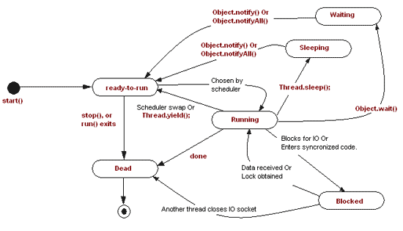
Thread Life cycle in Java

Slide 10
The start method creates the system resources, necessary to run the thread, schedules the thread to run, and calls the thread’s run method.
A thread becomes “Not Runnable” when one of these events occurs:
If sleep method is invoked.
The thread calls the wait method.
The thread is blocking on I/O.
A thread dies naturally when the run method exits.

Slide 11
Thread Scheduling
Execution of multiple threads on a single CPU, in some order, is called scheduling.
In general, the runnable thread with the highest priority is active (running)
Java is priority-preemptive
If a high-priority thread wakes up, and a low-priority thread is running
Then the high-priority thread gets to run immediately
Allows on-demand processing
Efficient use of CPU

Slide 12
1 Types of scheduling
Waiting and Notifying
Waiting [wait()] and notifying [notify(), notifyAll()] provides means of communication between threads that synchronize on the same object.
wait(): when wait() method is invoked on an object, the thread executing that code gives up its lock on the object immediately and moves the thread to the wait state.
notify(): This wakes up threads that called wait() on the same object and moves the thread to ready state.
notifyAll(): This wakes up all the threads that called wait() on the same object.

Slide 13
Running and Yielding
Yield() is used to give the other threads of the same priority a chance to execute i.e. causes current running thread to move to runnable state.
Sleeping and Waking up
nSleep() is used to pause a thread for a specified period of time i.e. moves the current running thread to Sleep state for a specified amount of time, before moving it to runnable state. Thread.sleep(no. of milliseconds);

Slide 14
Thread Priority
When a Java thread is created, it inherits its priority from the thread that created it.
You can modify a thread’s priority at any time after its creation using the setPriority method.
Thread priorities are integers ranging between MIN_PRIORITY (1) and MAX_PRIORITY (10) . The higher the integer, the higher the priority.Normally the thread priority will be 5.

Slide 15
isAlive() and join() methods
isAlive() method is used to determine if a thread is still alive. It is the best way to determine if a thread has been started but has not yet completed its run() method. final boolean isAlive();
The nonstatic join() method of class Thread lets one thread “join onto the end” of another thread. This method waits until the thread on which it is called terminates. final void join();

Slide 16
Blocking Threads
When reading from a stream, if input is not available, the thread will block
Thread is suspended (“blocked”) until I/O is available
Allows other threads to automatically activate
When I/O available, thread wakes back up again
Becomes “runnable” i.e. gets into ready state

Slide 17
Grouping of threads
Thread groups provide a mechanism for collecting multiple threads into a single object and manipulating those threads all at once, rather than individually.
To put a new thread in a thread group the group must
be explicitly specified when the thread is created
– public Thread(ThreadGroup group, Runnable runnable)
– public Thread(ThreadGroup group, String name)
– public Thread(ThreadGroup group, Runnable runnable, String name)
A thread can not be moved to a new group after the thread has been created.
When a Java application first starts up, the Java runtime system creates a ThreadGroup named main.
Java thread groups are implemented by the java.lang.ThreadGroup class.

Slide 18
Commonly used Constructors of Thread class
Commonly used Constructors of Thread class:
Thread()
Thread(String name)
Thread(Runnable r)
Thread(Runnable r,String name)

Slide 19
Commonly used methods of Thread class:
public void run(): is used to perform action for a thread.
public void start(): starts the execution of the thread.JVM calls the run() method on the thread.
public void sleep(long miliseconds): Causes the currently executing thread to sleep (temporarily cease execution) for the specified number of milliseconds.
public void join(): waits for a thread to die.
public void join(long miliseconds): waits for a thread to die for the specified miliseconds.

Slide 20
public int getPriority(): returns the priority of the thread.
public int setPriority(int priority): changes the priority of the thread.
public String getName(): returns the name of the thread.
public void setName(String name): changes the name of the thread.
public Thread currentThread(): returns the reference of currently executing thread.
public int getId(): returns the id of the thread.

Slide 21
public Thread.State getState(): returns the state of the thread.
public boolean isAlive(): tests if the thread is alive.
public void yield(): causes the currently executing thread object to temporarily pause and allow other threads to execute.
public void suspend(): is used to suspend the thread(depricated).
public void resume(): is used to resume the suspended thread(depricated).
public void stop(): is used to stop the thread(depricated).
public boolean isDaemon(): tests if the thread is a daemon thread.
public void setDaemon(boolean b): marks the thread as daemon or user thread.
public void interrupt(): interrupts the thread.
public boolean isInterrupted(): tests if the thread has been interrupted.
public static boolean interrupted(): tests if the current thread has been interrupted.

Slide 22
Thread Scheduler in Java
A component of Java that decides which thread to run or execute and which thread to wait is called a thread scheduler in Java. In Java, a thread is only chosen by a thread scheduler if it is in the runnable state. However, if there is more than one thread in the runnable state, it is up to the thread scheduler to pick one of the threads and ignore the other ones. There are some criteria that decide which thread will execute first. There are two factors for scheduling a thread i.e. Priority and Time of arrival.

Slide 23
Priority: Priority of each thread lies between 1 to 10. If a thread has a higher priority, it means that thread has got a better chance of getting picked up by the thread scheduler.
Time of Arrival: Suppose two threads of the same priority enter the runnable state, then priority cannot be the factor to pick a thread from these two threads. In such a case, arrival time of thread is considered by the thread scheduler. A thread that arrived first gets the preference over the other threads.

Slide 24
Thread Scheduler Algorithms
On the basis of the above-mentioned factors, the scheduling algorithm is followed by a Java thread scheduler.

Slide 25
First Come First Serve Scheduling:
In this scheduling algorithm, the scheduler picks the threads thar arrive first in the runnable queue. Observe the following table:
Threads | Time arrival
t1 | 0
t2 | 1
t3 | 2
t4 | 3

Slide 26
In the above table, we can see that Thread t1 has arrived first, then Thread t2, then t3, and at last t4, and the order in which the threads will be processed is according to the time of arrival of threads.
Thread Scheduler in Java
Hence, Thread t1 will be processed first, and Thread t4 will be processed last.
t1 | t2 | t3 | t4

Slide 27
Time-slicing scheduling:
Usually, the First Come First Serve algorithm is non-preemptive, which is bad as it may lead to infinite blocking (also known as starvation). To avoid that, some time-slices are provided to the threads so that after some time, the running thread has to give up the CPU. Thus, the other waiting threads also get time to run their job.

Slide 28
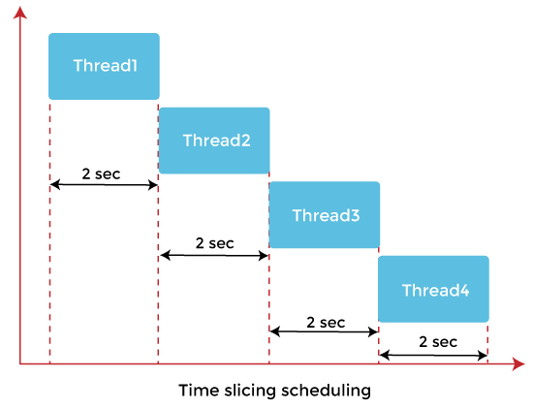

Slide 29
In the above diagram, each thread is given a time slice of 2 seconds. Thus, after 2 seconds, the first thread leaves the CPU, and the CPU is then captured by Thread2. The same process repeats for the other threads too.

Slide 30
Preemptive-Priority Scheduling:
The name of the scheduling algorithm denotes that the algorithm is related to the priority of the threads.

Slide 31
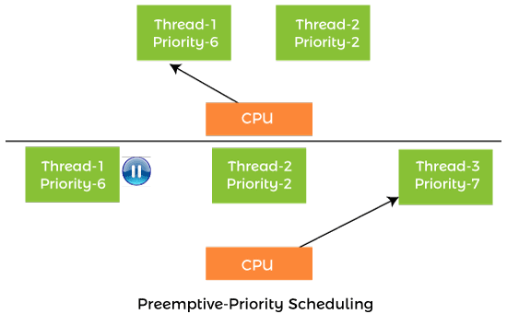

Slide 32
Suppose there are multiple threads available in the runnable state. The thread scheduler picks that thread that has the highest priority. Since the algorithm is also preemptive, therefore, time slices are also provided to the threads to avoid starvation. Thus, after some time, even if the highest priority thread has not completed its job, it has to release the CPU because of preemption.

Slide 33
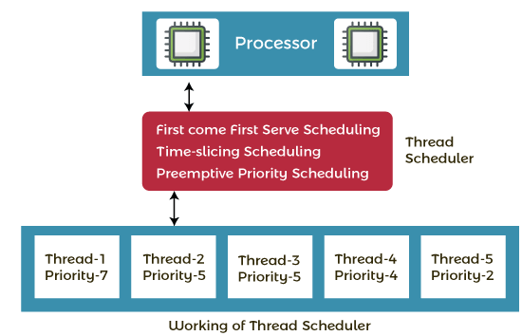
Working of the Java Thread Scheduler

Slide 34
Let's understand the working of the Java thread scheduler. Suppose, there are five threads that have different arrival times and different priorities. Now, it is the responsibility of the thread scheduler to decide which thread will get the CPU first.

Slide 35
The thread scheduler selects the thread that has the highest priority, and the thread begins the execution of the job. If a thread is already in runnable state and another thread (that has higher priority) reaches in the runnable state, then the current thread is pre-empted from the processor, and the arrived thread with higher priority gets the CPU time.
When two threads (Thread 2 and Thread 3) having the same priorities and arrival time, the scheduling will be decided on the basis of FCFS algorithm. Thus, the thread that arrives first gets the opportunity to execute first.

Slide 36
Interrupting a Thread:
If any thread is in sleeping or waiting state (i.e. sleep() or wait() is invoked), calling the interrupt() method on the thread, breaks out the sleeping or waiting state throwing InterruptedException. If the thread is not in the sleeping or waiting state, calling the interrupt() method performs normal behaviour and doesn't interrupt the thread but sets the interrupt flag to true. Let's first see the methods provided by the Thread class for thread interruption.

Slide 37
The 3 methods provided by the Thread class for interrupting a thread
public void interrupt()
public static boolean interrupted()
public boolean isInterrupted()

Slide 38
Example of interrupting a thread that stops working
In this example, after interrupting the thread, we are propagating it, so it will stop working. If we don't want to stop the thread, we can handle it where sleep() or wait() method is invoked. Let's first see the example where we are propagating the exception.

Slide 39
public class JavaInterruptExp1 extends Thread
{
public void run()
{
try
{
Thread.sleep(1000);
System.out.println("javatpoint");
}catch(InterruptedException e){
throw new RuntimeException("Thread interrupted..."+e);
}
}
public static void main(String args[])
{
JavaInterruptExp1 t1=new JavaInterruptExp1();
t1.start();
try
{
t1.interrupt();
}catch(Exception e){System.out.println("Exception handled "+e);}
}
}

Slide 40
public class JavaInterruptExp3 extends Thread
{
public void run()
{
for(int i=1; i<=5; i++)
System.out.println(i);
}
public static void main(String args[])
{
JavaInterruptExp3 t1=new JavaInterruptExp3();
// call run() method
t1.start();
t1.interrupt();
}
}

Slide 41
Synchronization in Java
Synchronization in Java is the capability to control the access of multiple threads to any shared resource.
Java Synchronization is better option where we want to allow only one thread to access the shared resource.

Slide 42
3 ways Synchronized
1) Synchronized method.
2)Synchronized block.
3) Static synchronization.

Slide 43
Without Synchronized

Slide 44
Java Synchronized Method
If you declare any method as synchronized, it is known as synchronized method.
Synchronized method is used to lock an object for any shared resource.
When a thread invokes a synchronized method, it automatically acquires the lock for that object and releases it when the thread completes its task.

Slide 45
Java Synchronized Method
If you declare any method as synchronized, it is known as synchronized method.
Synchronized method is used to lock an object for any shared resource.
When a thread invokes a synchronized method, it automatically acquires the lock for that object and releases it when the thread completes its task.

Slide 46
class Table{
synchronized void printTable(int n){//synchronized method
for(int i=1;i<=5;i++){
System.out.println(n*i);
try{
Thread.sleep(400);
}catch(Exception e){System.out.println(e);}
}
}
}
class MyThread1 extends Thread{
Table t;
MyThread1(Table t){
this.t=t;
}
public void run(){
t.printTable(5);
}
}
class MyThread2 extends Thread{
Table t;
MyThread2(Table t){
this.t=t;
}
public void run(){
t.printTable(100);
}
}
public class TestSynchronization2{
public static void main(String args[]){
Table obj = new Table();//only one object
MyThread1 t1=new MyThread1(obj);
MyThread2 t2=new MyThread2(obj);
t1.start();
t2.start();
}
}

Slide 47
Synchronized Block in Java
Synchronized block can be used to perform synchronization on any specific resource of the method.
Suppose we have 50 lines of code in our method, but we want to synchronize only 5 lines, in such cases, we can use synchronized block.
If we put all the codes of the method in the synchronized block, it will work same as the synchronized method.

Slide 48
Syntax
synchronized (object reference expression) {
//code block
}

Slide 49
class Table
{
void printTable(int n){
synchronized(this){//synchronized block
for(int i=1;i<=5;i++){
System.out.println(n*i);
try{
Thread.sleep(400);
}catch(Exception e){System.out.println(e);}
}
}
}//end of the method
}
class MyThread1 extends Thread{
Table t;
MyThread1(Table t){
this.t=t;
}
public void run(){
t.printTable(5);
}
}
class MyThread2 extends Thread{
Table t;
MyThread2(Table t){
this.t=t;
}
public void run(){
t.printTable(100);
}
}
public class TestSynchronizedBlock1{
public static void main(String args[]){
Table obj = new Table();//only one object
MyThread1 t1=new MyThread1(obj);
MyThread2 t2=new MyThread2(obj);
t1.start();
t2.start();
}
}

Slide 50
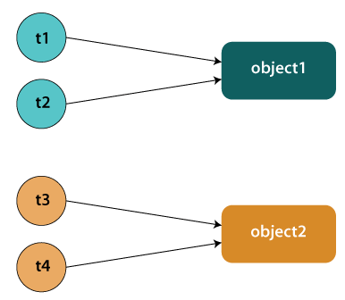
Static Synchronization

Slide 51
Problem without static synchronization
Suppose there are two objects of a shared class (e.g. Table) named object1 and object2. In case of synchronized method and synchronized block there cannot be interference between t1 and t2 or t3 and t4 because t1 and t2 both refers to a common object that have a single lock. But there can be interference between t1 and t3 or t2 and t4 because t1 acquires another lock and t3 acquires another lock. We don't want interference between t1 and t3 or t2 and t4. Static synchronization solves this problem.

Slide 52
class Table
{
synchronized static void printTable(int n){
for(int i=1;i<=10;i++){
System.out.println(n*i);
try{
Thread.sleep(400);
}catch(Exception e){}
}
}
}
class MyThread1 extends Thread{
public void run(){
Table.printTable(1);
}
}
class MyThread2 extends Thread{
public void run(){
Table.printTable(10);
}
}
class MyThread3 extends Thread{
public void run(){
Table.printTable(100);
}
}
class MyThread4 extends Thread{
public void run(){
Table.printTable(1000);
}
}
public class TestSynchronization4{
public static void main(String t[]){
MyThread1 t1=new MyThread1();
MyThread2 t2=new MyThread2();
MyThread3 t3=new MyThread3();
MyThread4 t4=new MyThread4();
t1.start();
t2.start();
t3.start();
t4.start();
}
}

Slide 53
Java Networking
Java Networking is a concept of connecting two or more computing devices together so that we can share resources.
Java socket programming provides facility to share data between different computing devices.
Advantage of Java Networking
Sharing resources
Centralize software management

Slide 54
The java.net package supports two protocols,
TCP: Transmission Control Protocol provides reliable communication between the sender and receiver. TCP is used along with the Internet Protocol referred as TCP/IP.
UDP: User Datagram Protocol provides a connection-less protocol service by allowing packet of data to be transferred along two or more nodes

Slide 55
Java Networking Terminology
IP Address
Protocol
Port Number
MAC Address
Connection-oriented and connection-less protocol
Socket

Slide 56
1) IP Address
IP address is a unique number assigned to a node of a network e.g. 192.168.0.1 . It is composed of octets that range from 0 to 255.
It is a logical address that can be changed.
2) Protocol
A protocol is a set of rules basically that is followed for communication. For example:
TCP
FTP
Telnet
SMTP
POP etc.

Slide 57
3) Port Number
The port number is used to uniquely identify different applications. It acts as a communication endpoint between applications.
The port number is associated with the IP address for communication between two applications.
4) MAC Address
MAC (Media Access Control) address is a unique identifier of NIC (Network Interface Controller). A network node can have multiple NIC but each with unique MAC address.
For example, an ethernet card may have a MAC address of 00:0d:83::b1:c0:8e.

Slide 58
5) Connection-oriented and connection-less protocol
In connection-oriented protocol, acknowledgement is sent by the receiver. So it is reliable but slow. The example of connection-oriented protocol is TCP.
But, in connection-less protocol, acknowledgement is not sent by the receiver. So it is not reliable but fast. The example of connection-less protocol is UDP.

Slide 59
Java InetAddress class
Java InetAddress class represents an IP address. The java.net.InetAddress class provides methods to get the IP of any host name for example www.javatpoint.com, www.google.com, www.facebook.com, etc.
An IP address is represented by 32-bit or 128-bit unsigned number. An instance of InetAddress represents the IP address with its corresponding host name. There are two types of addresses: Unicast and Multicast. The Unicast is an identifier for a single interface whereas Multicast is an identifier for a set of interfaces.
Moreover, InetAddress has a cache mechanism to store successful and unsuccessful host name resolutions.

Slide 60
IP Address
An IP address helps to identify a specific resource on the network using a numerical representation.
Most networks combine IP with TCP (Transmission Control Protocol). It builds a virtual bridge among the destination and the source.

Slide 61
There are two versions of IP address:
1. IPv4
IPv4 is the primary Internet protocol. It is the first version of IP deployed for production in the ARAPNET in 1983. It is a widely used IP version to differentiate devices on network using an addressing scheme. A 32-bit addressing scheme is used to store 232 addresses that is more than 4 million addresses.
Features of IPv4:
It is a connectionless protocol.
It utilizes less memory and the addresses can be remembered easily with the class based addressing scheme.
It also offers video conferencing and libraries.

Slide 62
2. IPv6
IPv6 is the latest version of Internet protocol. It aims at fulfilling the need of more internet addresses. It provides solutions for the problems present in IPv4. It provides 128-bit address space that can be used to form a network of 340 undecillion unique IP addresses. IPv6 is also identified with a name IPng (Internet Protocol next generation).
Features of IPv6:
It has a stateful and stateless both configurations.
It provides support for quality of service (QoS).
It has a hierarchical addressing and routing infrastructure.

Slide 63
TCP/IP Protocol
TCP/IP is a communication protocol model used connect devices over a network via internet.
TCP/IP helps in the process of addressing, transmitting, routing and receiving the data packets over the internet.

Slide 64
Method Description
public static InetAddress getByName(String host) throws UnknownHostException It returns the instance of InetAddress containing LocalHost IP and name.
public static InetAddress getLocalHost() throws UnknownHostException It returns the instance of InetAdddress containing local host name and address.
public String getHostName() It returns the host name of the IP address.
public String getHostAddress() It returns the IP address in string format.

Slide 65
Example of Java InetAddress Class
import java.io.*;
import java.net.*;
public class InetDemo{
public static void main(String[] args){
try{
InetAddress ip=InetAddress.getByName("www.google.com");
System.out.println("Host Name: "+ip.getHostName());
System.out.println("IP Address: "+ip.getHostAddress());
}catch(Exception e){System.out.println(e);}
}
}

Slide 66

Java URL
The Java URL class represents an URL. URL is an acronym for Uniform Resource Locator. It points to a resource on the World Wide Web. For example:
URL in Java

Slide 67
A URL contains many information:
Protocol: In this case, http is the protocol.
Server name or IP Address: In this case, www.google.com is the server name.
Port Number: It is an optional attribute. If we write http//ww.javatpoint.com:80/sonoojaiswal/ , 80 is the port number. If port number is not mentioned in the URL, it returns -1.
File Name or directory name: In this case, index.jsp is the file name.

Slide 69
Java Socket Programming
java Socket programming is used for communication between the applications running on different JRE.
Java Socket programming can be connection-oriented or connection-less.
Socket and ServerSocket classes are used for connection-oriented socket programming and DatagramSocket and DatagramPacket classes are used for connection-less socket programming.

Slide 70
6) Socket
A socket is an endpoint between two way communications.

Slide 71
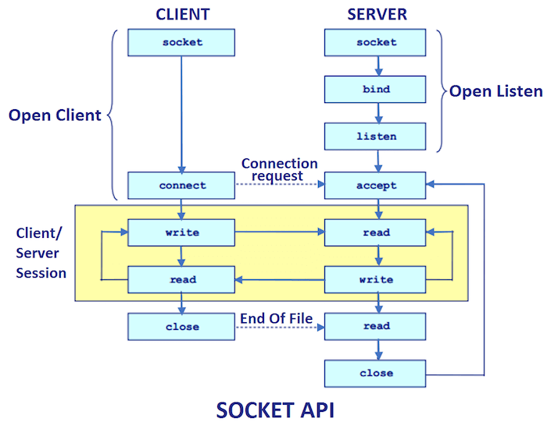

Slide 72
The client in socket programming must know two information
P Address of Server, and
Port number.
Here, we are going to make one-way client and server communication. In this application, client sends a message to the server, server reads the message and prints it. Here, two classes are being used: Socket and ServerSocket. The Socket class is used to communicate client and server. Through this class, we can read and write message. The ServerSocket class is used at server-side. The accept() method of ServerSocket class blocks the console until the client is connected. After the successful connection of client, it returns the instance of Socket at server-side.

Slide 73
Example of Java Socket Programming
Creating Server:
To create the server application, we need to create the instance of ServerSocket class. Here, we are using 6666 port number for the communication between the client and server. You may also choose any other port number. The accept() method waits for the client. If clients connects with the given port number, it returns an instance of Socket.
ServerSocket ss=new ServerSocket(6666);
Socket s=ss.accept();//establishes connection and waits for the client

Slide 74
Creating Client:
To create the client application, we need to create the instance of Socket class. Here, we need to pass the IP address or hostname of the Server and a port number. Here, we are using "localhost" because our server is running on same system.
Socket s=new Socket("localhost",6666);
Let's see a simple of Java socket programming where client sends a text and server receives and prints it.

Slide 75
import java.io.*;
import java.net.*;
public class MyServer {
public static void main(String[] args){
try{
ServerSocket ss=new ServerSocket(6666);
Socket s=ss.accept();//establishes connection
DataInputStream dis=new DataInputStream(s.getInputStream());
String str=(String)dis.readUTF();
System.out.println("message= "+str);
ss.close();
}catch(Exception e){System.out.println(e);}
}
}

Slide 76
import java.io.*;
import java.net.*;
public class MyClient {
public static void main(String[] args) {
try{
Socket s=new Socket("localhost",6666);
DataOutputStream dout=new DataOutputStream(s.getOutputStream());
dout.writeUTF("Hello Server");
dout.flush();
dout.close();
s.close();
}catch(Exception e){System.out.println(e);}
}
}

